Slide 1
Crowdfunding Platform
Suraj Kumar

Slide 2
Functional Requirements
Authentication
Users with roles (innovator, user, admin) should be able to register, sign in and sign out on the platform
Project Management
Innovator can create, edit and delete projects
Browse their previous projects
Provide search functionality for donors to access project via title
Request contributions for a specific amount in a certain time range
Project should be archived
Either donation amount is reached
Project end date is completed
Donated money should go back to innovator once project is completed.
Donations
Access all projects with filter
Donors can donate towards project
Access their previous donations
OOS
Innovator notifications on project status
Upload photos on projects

Slide 3
Non functional requirements
Availability
Platform should have 99.9 uptime
Scalability
Platform should be scalable to support increasing projects and users without performance degradation
Throughput
Platform should support high throughput
Latency
Platform should not be latent. P50, p95, p99 should be within range
System should be secure with authentication and authorization.

Slide 4
Design
High level design
DB schema
Assumptions

Slide 5
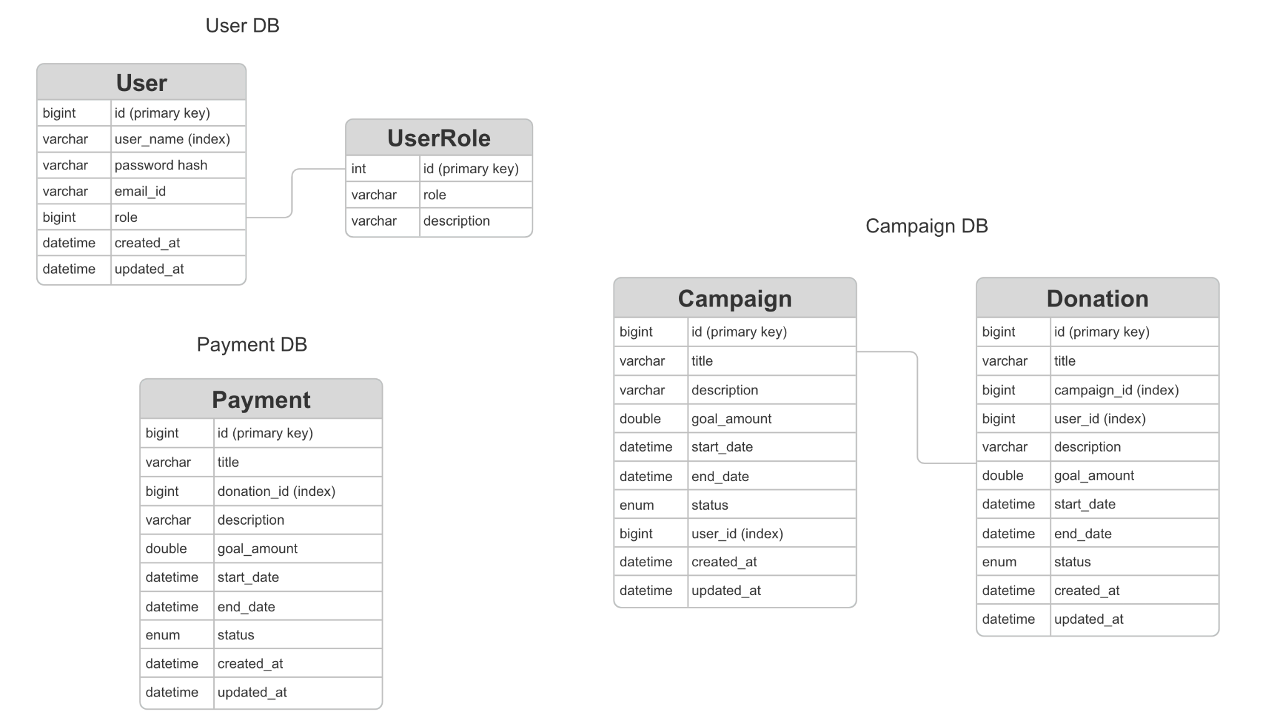
DB Schema

Slide 6
Considerations
Authentication -> Password based Authentication

